Slide 1



SCLoRa: Leveraging Multi-Dimensionality in Decoding Collided LoRa Transmissions
Bin Hu, Zhimeng Yin, Shuai Wang, Shuai Wang,
Zhuqing Xu, and Tian He
binhu@seu.edu.cn
Southeast University

Slide 2
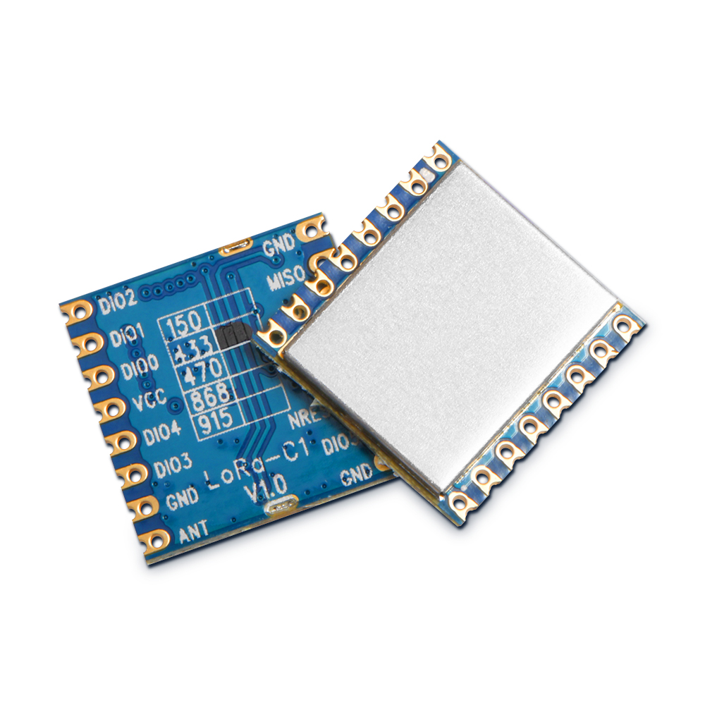














LPWAN
Long transmission range
Low power
Low cost
Low data rate

Slide 3

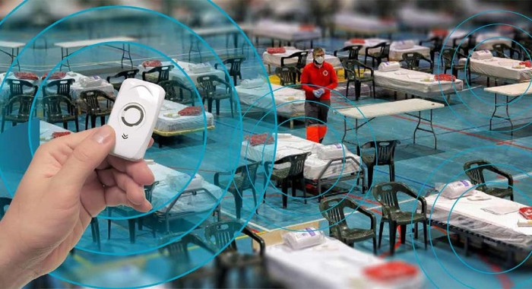
LoRa Technologies
An application in fighting COVID-19 pandemic
Battery lifetime: ~10 years
Data rates: 0.3-5.5kbps
RSSI minimum: -120 dBm
Physical range: 10KM+

Slide 4
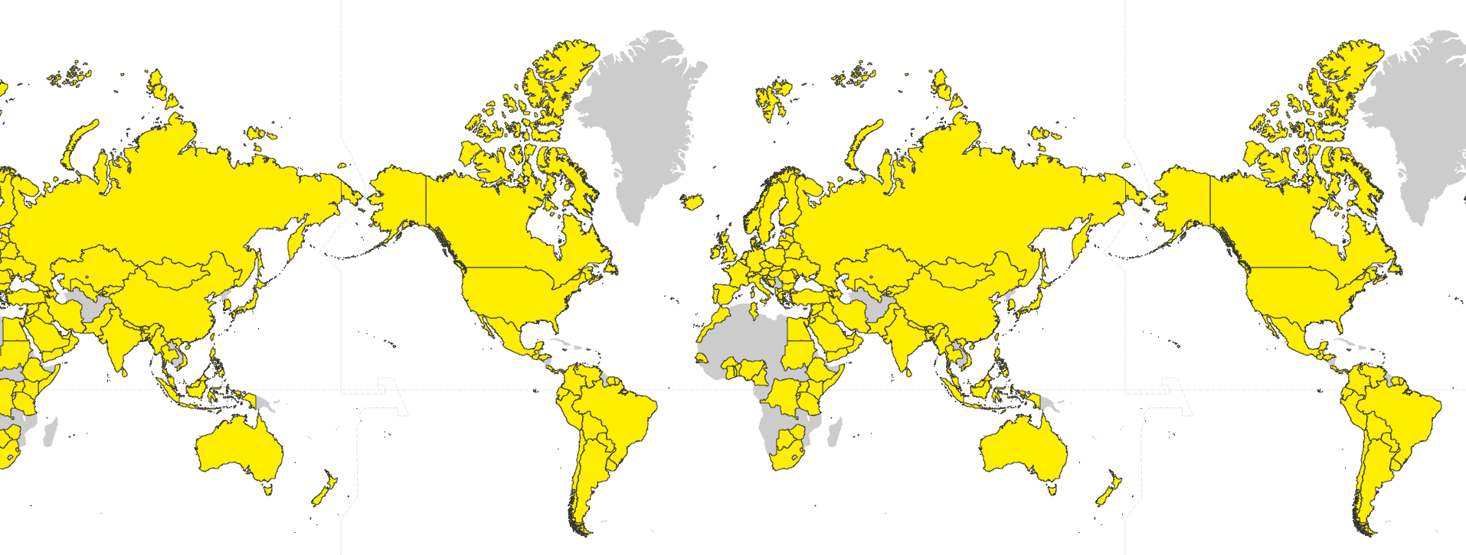
LoRa Deployment
143LoRaWAN® Network Operators in161Countries
Connection is expected to reach >1.1B devices by 2023

Slide 5

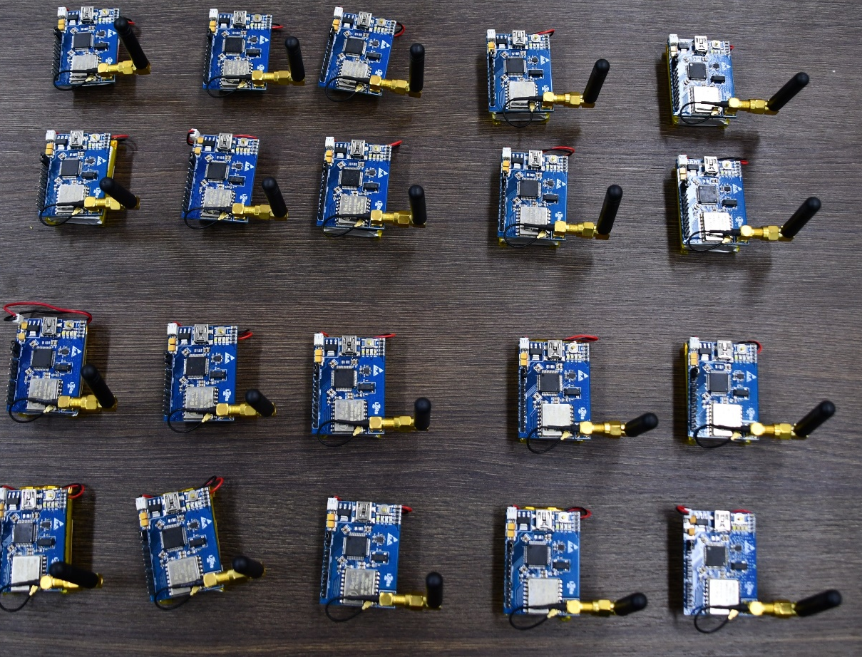
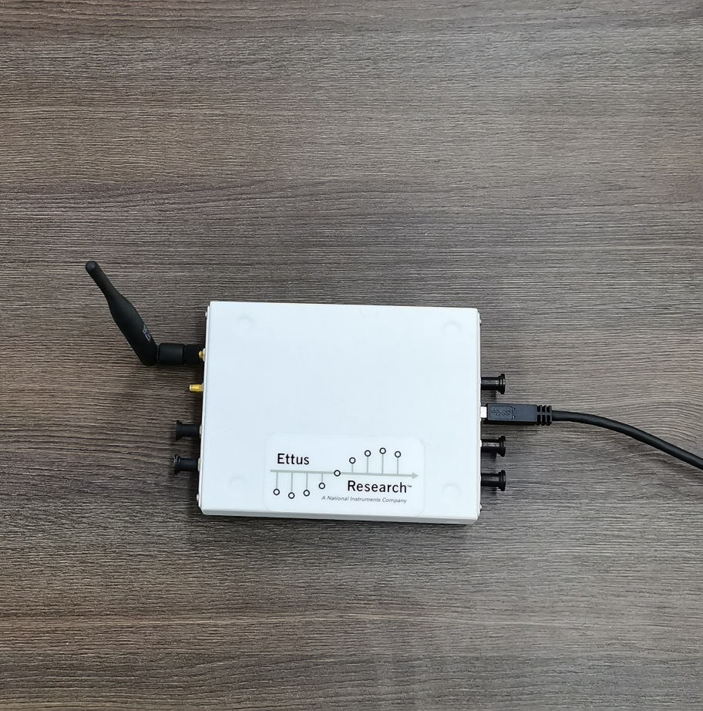









Motivation: Concurrent Transmissions & Collisions
Collisions
LoRa Nodes
Base Station
Base station
Modulation Errors
Concurrent Transmissions
Packet Losses

Slide 6
Existing Solutions (1/3)
MAC Solutions
S-MAC
Transmission scheduling
Q. Xu
LMAC
Collision detection
A. Gamage
INFOCOM
2020
MobiCom
2020
Choir
Frequency offset
R. Eletreby
FTrack
Frequency change
X. Xia
mLoRa
CSS&M-FSK
X. Wang
SIGCOMM2017
SenSys
2019
ICNP
2019
PHY Solutions

Slide 7


Existing Solutions (2/3)
Limitations of MAC Solutions in Concurrent Transmissions
Excessive mutual and detection information increases power budget.
The low cost of LoRa makes it challenging for excessive transmission scheduling.
2
1
4
3
Collision detection
Transmission scheduling

Slide 8
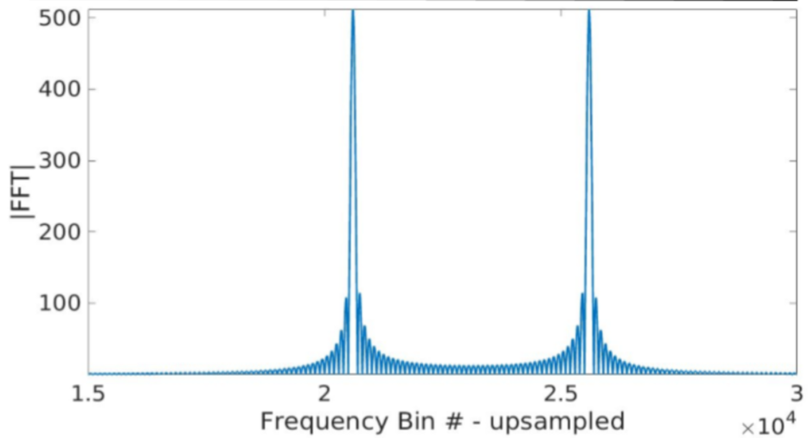
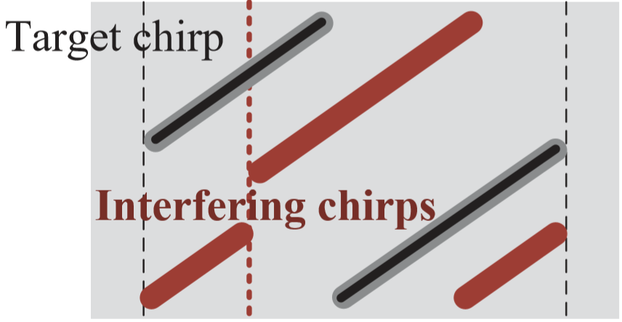
Existing Solutions (3/3)
Limitations of PHY Solutions in Concurrent Transmissions
Information for directed signal separation is not sufﬁcient under burst traffic.
The instability and similarity of signal under burst traffic cause demodulation errors.
Separation based on hardware frequency offsets
Separation based on frequency changes
(Choir)
(FTrack)

Slide 9
Opportunities
Key Idea：Leveraging Multi-Dimensionality in Decoding Collided LoRa Transmissions
Channel
Spreading Factor
Four Dimensions in LoRa Transmissions:
Frequency
Power
Single dimension
A single dimension of information is not easy to distinguish collided signals
Multi-dimensional information helps to improve the resolution of collided signals
Multi-dimensions

Slide 10
How to combine multi-dimensional features
to separate collided packets？

Slide 11
Design Overview
Collided Transmissions
Core Design
Enhanced Design
Symbol Classification
Spectrum Leakage Elimination
1. Spectral Coefficient
2. Cumulative Spectral coefficient
3. Peaks Evaluation
Preamble Detection
SCLoRa
Separated Transmissions

Slide 12
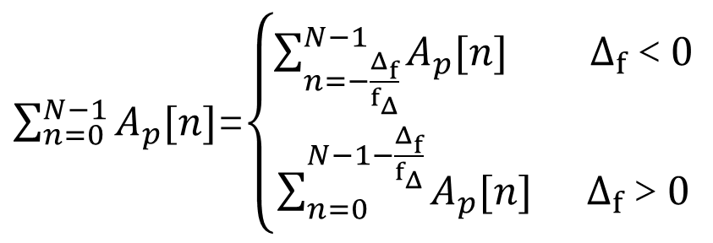
Introduction of Spectral Coefficient
Definition: The spectral coefficient is also called the Fourier series coefficient, which is a measure of the magnitude of each harmonic component in the signal.
Frequency
$\sum_{n=0}^{N−1}{A_{p}[n]}$=$\left\{\begin{aligned}\sum_{n=−\frac{Δ_{f}}{f_{Δ}}}^{N−1}{A_{p}[n]} Δ_{f}＜0 \\ \sum_{n=0}^{N−1−\frac{Δ_{f}}{f_{Δ}}}{A_{p}[n]} Δ_{f}＞0\end{aligned}\right.$
The spectral coefficient combines frequency and power.
Power

Slide 13
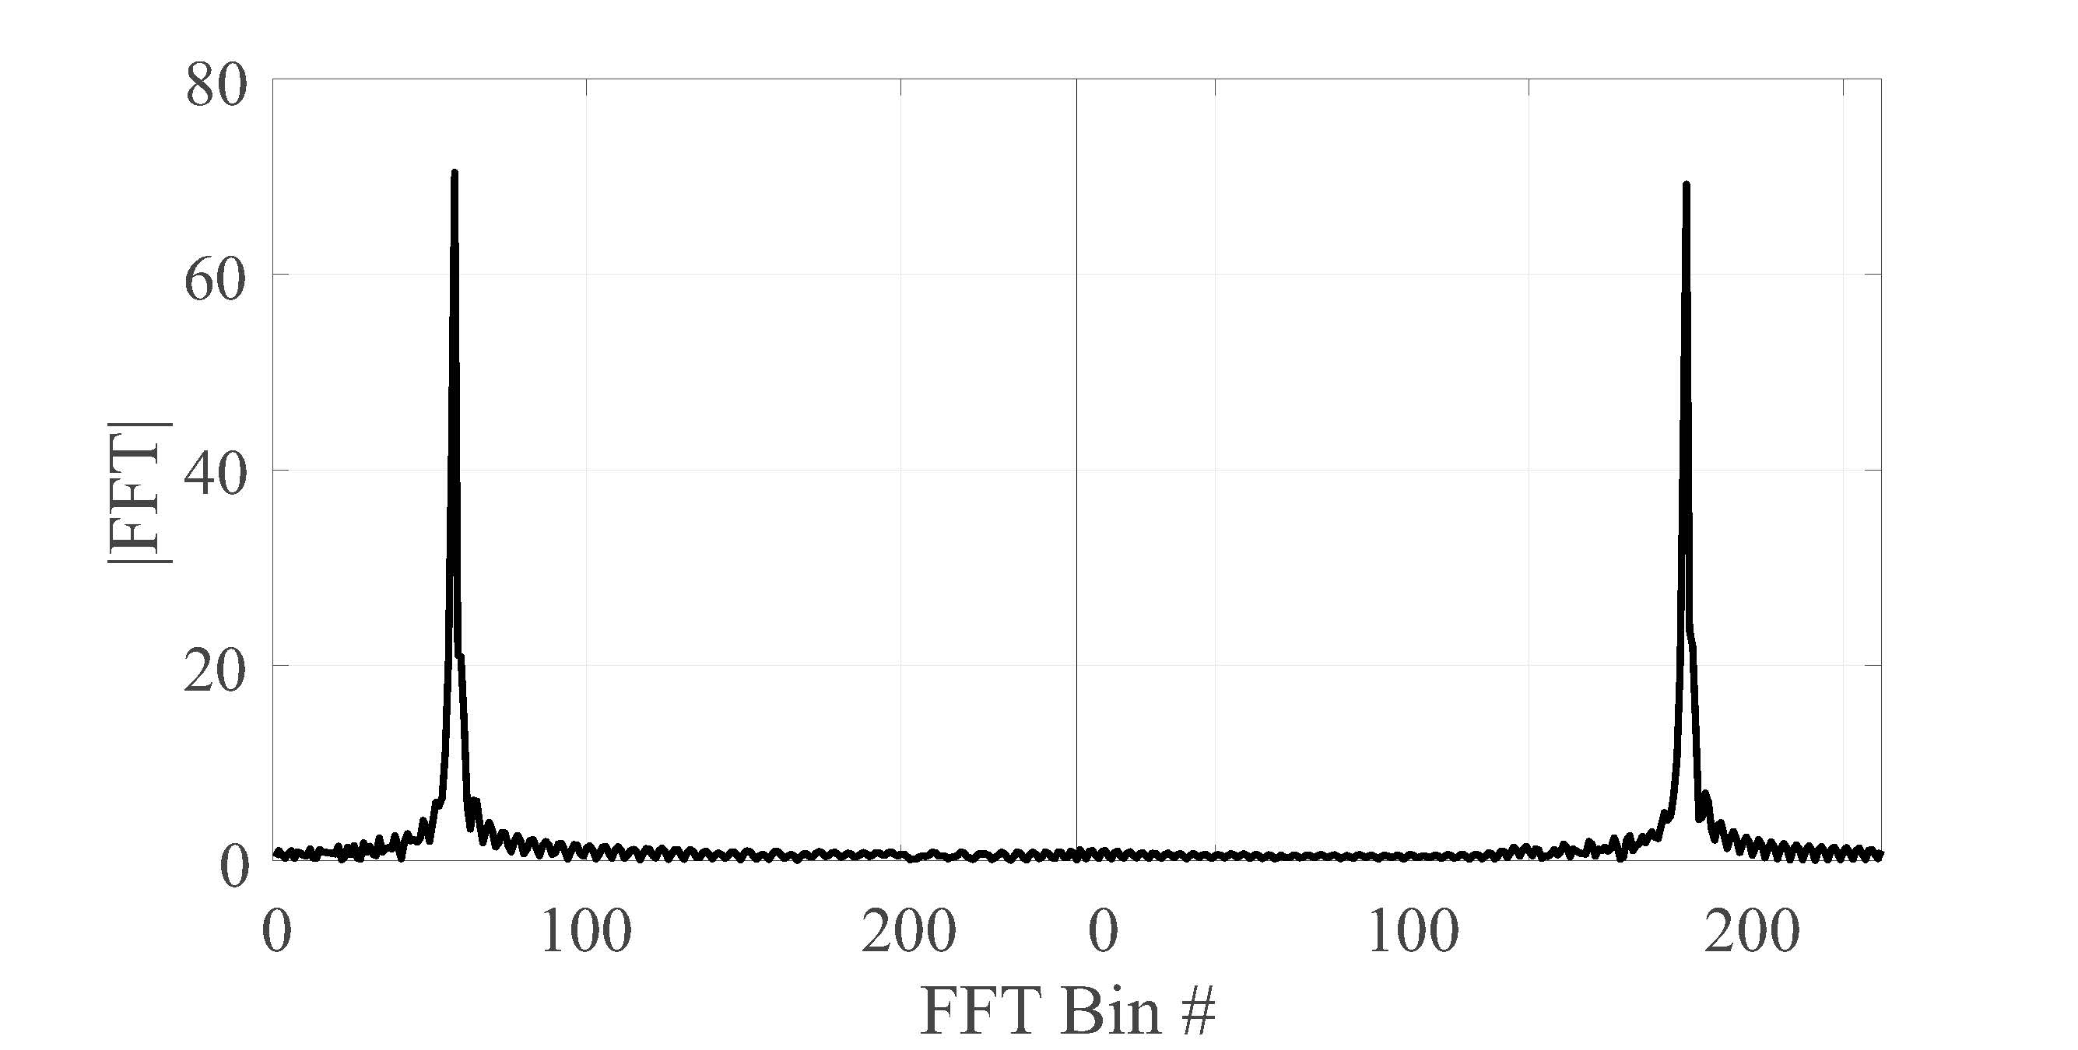
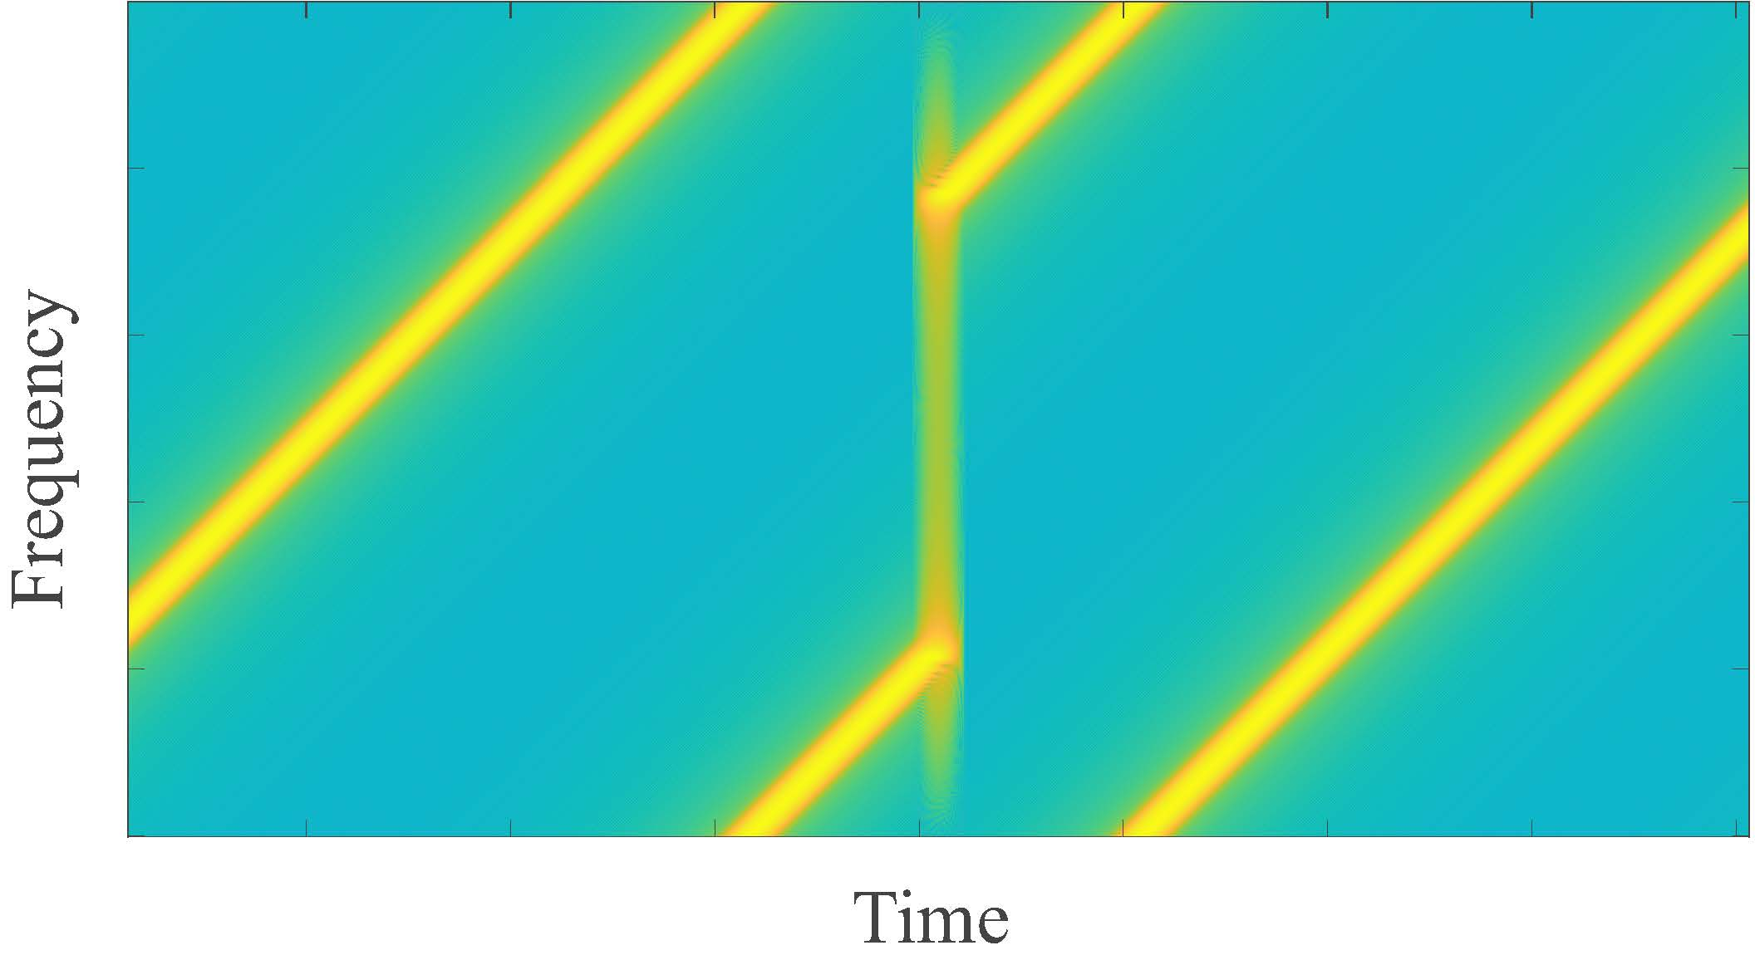
Introduction of Spectral Coefficient
The spectral coefﬁcients are stable within a LoRa transmission and are different across distinct LoRa transmitters.
The same spectral coefficient

Slide 14
Can the spectral coefficient be directly used to separate collided transmissions in practice?

Slide 15
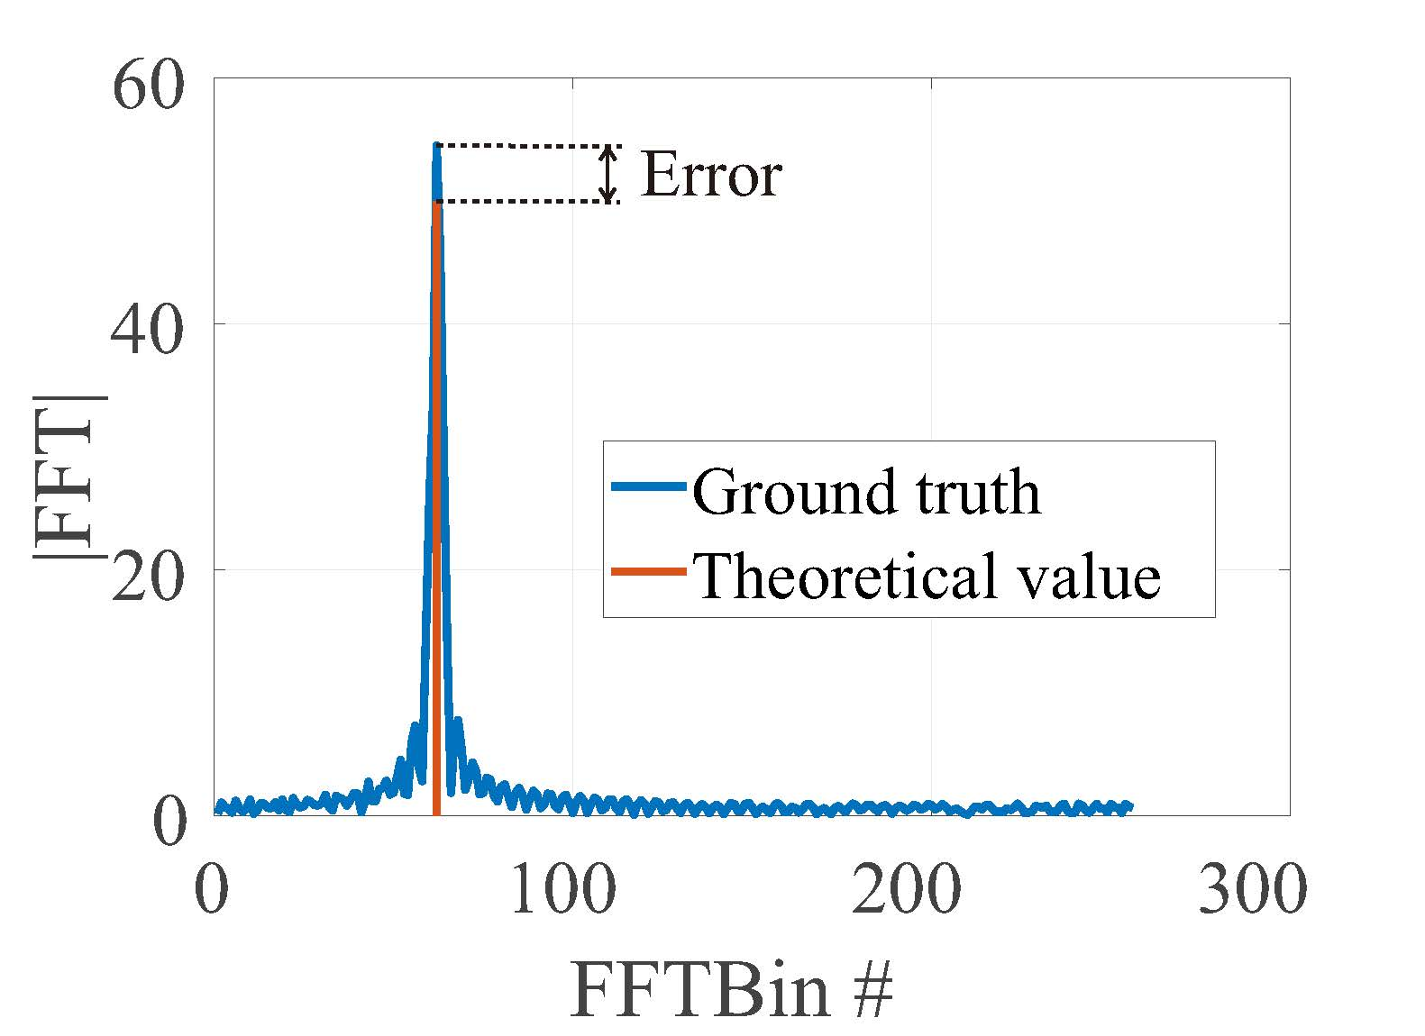
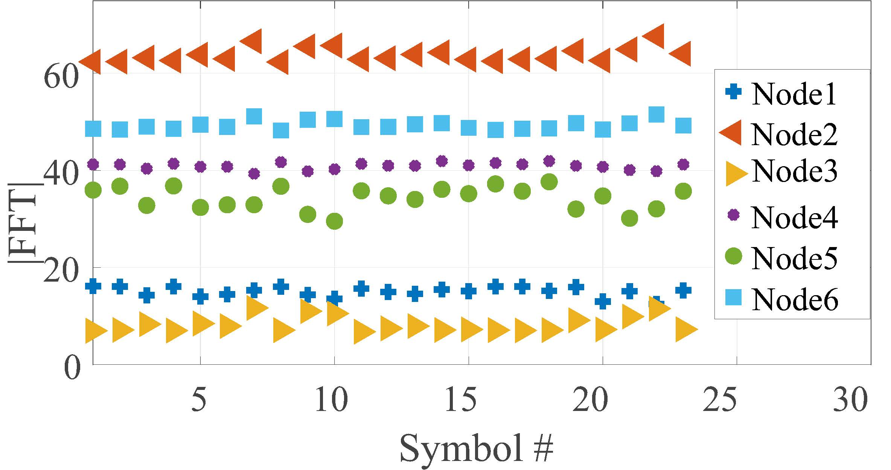
Spectral coefficient in reality
Since LoRa transmissions are affected by the channel fading, the spectral coefficient is volatile.

Slide 16
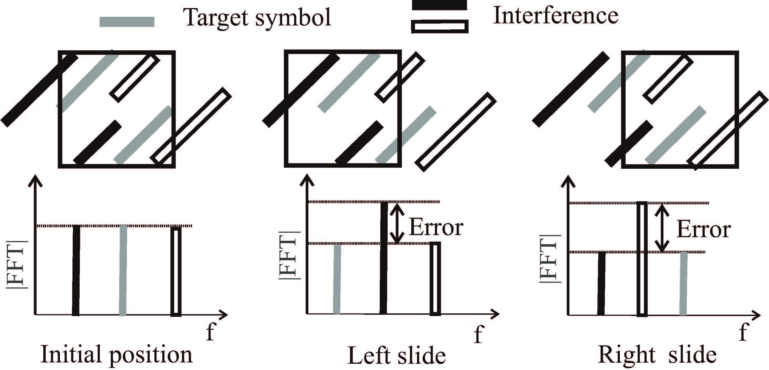
Cumulative spectral coefficient
Cumulative spectral coefficient increases reliability and differentiability.
${CSC}_{P}\left[Δ_{f}\right]=S_{p}\left[pf_{Δ}+Δ_{f}\right] ， −$ $f_{w}$＜ $Δ_{f}<$ $f_{w}$

Slide 17
Cumulative spectral coefficient
Initial position
|FFT|
Frequency offset

Slide 18
Cumulative spectral coefficient
Left slide
|FFT|
Frequency offset

Slide 19
Cumulative spectral coefficient
Right slide
|FFT|
Frequency offset

Slide 20
Cumulative spectral coefficient
Left slide
|FFT|
Frequency offset

Slide 21
Cumulative spectral coefficient
Right slide
|FFT|
Frequency offset

Slide 22
Cumulative spectral coefficient
Slide results
|FFT|
Frequency offset

Slide 23
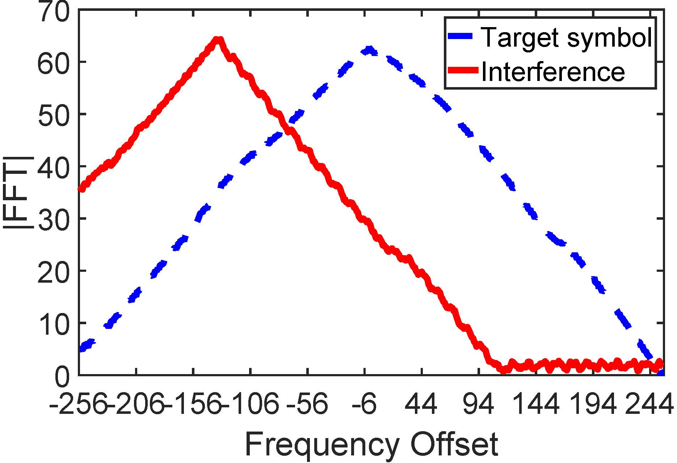
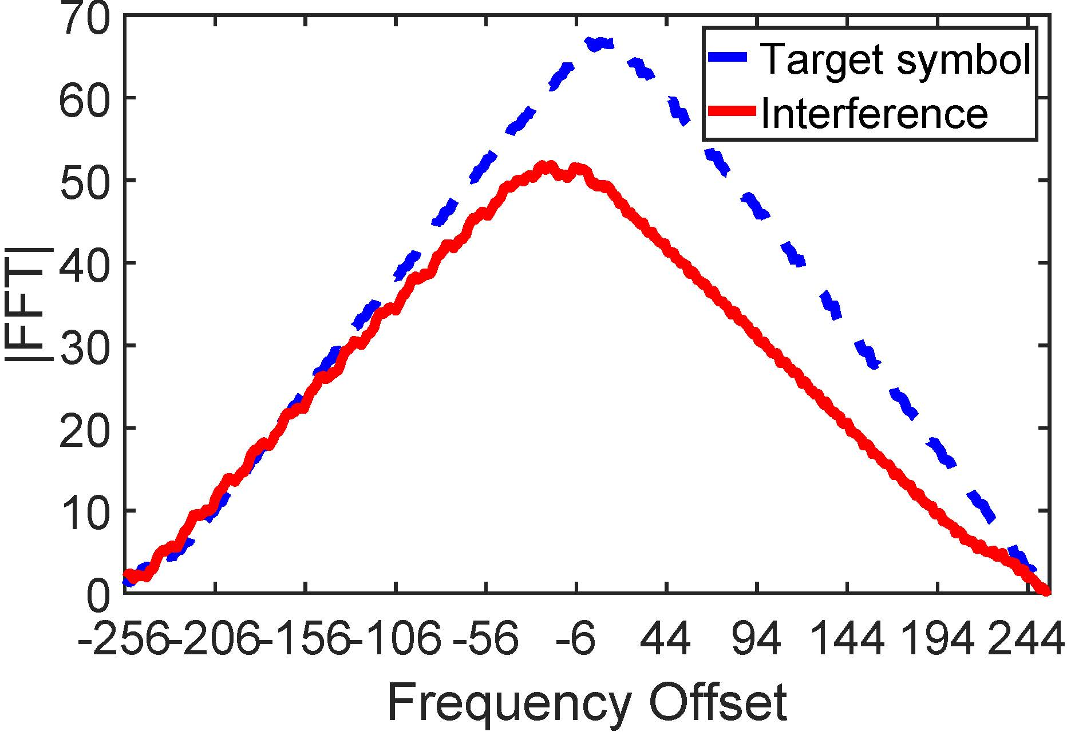
Cumulative spectral coefficient
Actual results of cumulative evaluation of spectral coefficients
Different signal boundaries
Similar signal boundaries
Similar power
Different power

Slide 24
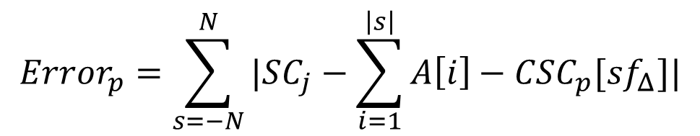
Peaks Evaluation
$$Error_{p}=\sum_{s=−N}^{N}{|SC_{j}−\sum_{i=1}^{\left|s\right|}{A\left[i\right]}−CSC_{p}[sf_{Δ}]|}$$
Cumulative Error
Collided Transmissions
Separated Transmissions

Slide 25
Design Overview
Collided Transmissions
Core Design
Enhanced Design
Symbol Classification
Spectrum Leakage Elimination
1. Spectral Coefficient
2. Cumulative Spectral coefficient
3. Peaks Evaluation
Preamble Detection
SCLoRa
Separated Transmissions

Slide 26
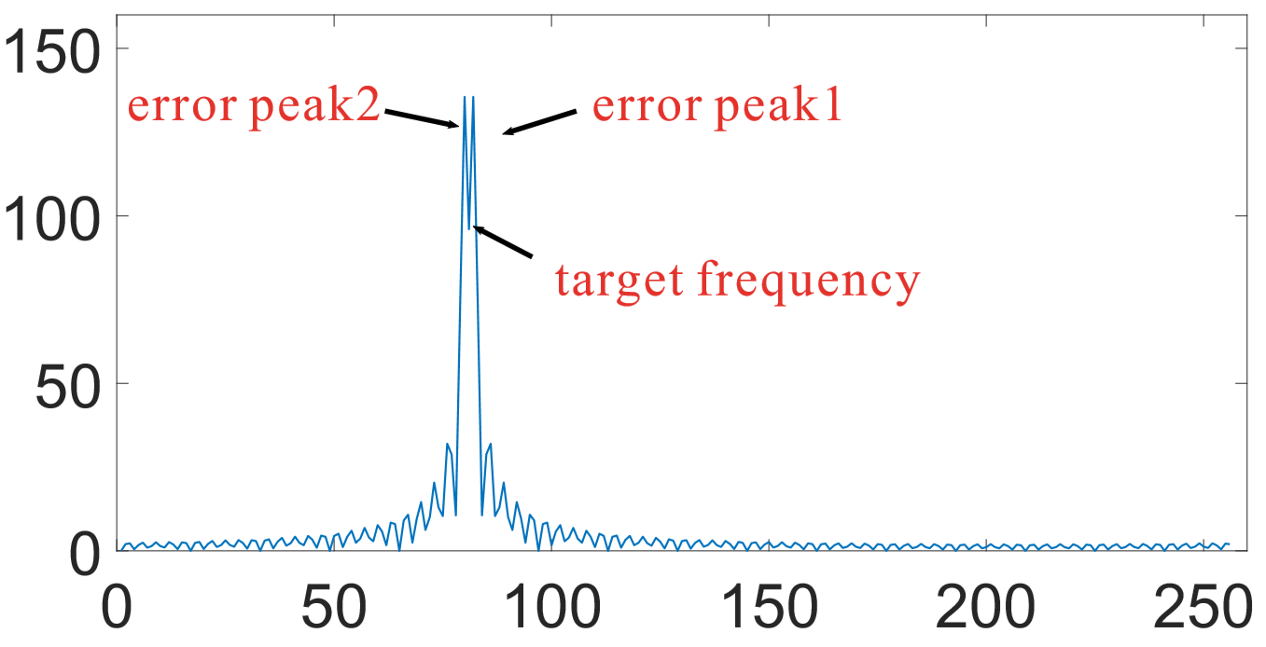
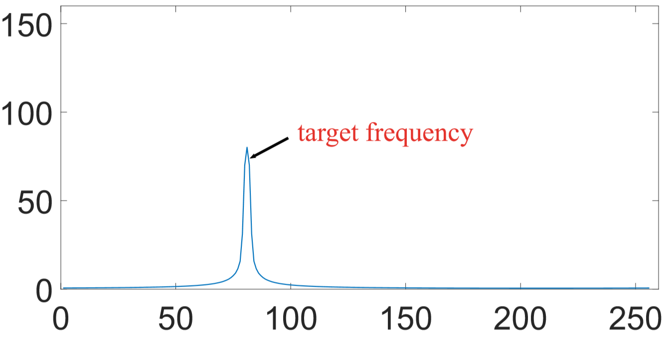
Enhanced Design: Spectrum Leakage Elimination
|FFT|
|FFT|
FFT Bin#
FFT Bin#
Window function can change the proportional relationship between main lobe and side lobe.
For details, pls refer to our paper…

Slide 27
Enhanced Design: Preamble Detection
window1
window2
window3
window4
window5
|FFT|
FFT Bin#
FFT Bin#
FFT Bin#
FFT Bin#
FFT Bin#
Preamble detection is based on the continuously repeated peaks with the same frequency and spectral coefﬁcient.
For details, pls refer to our paper…

Slide 28
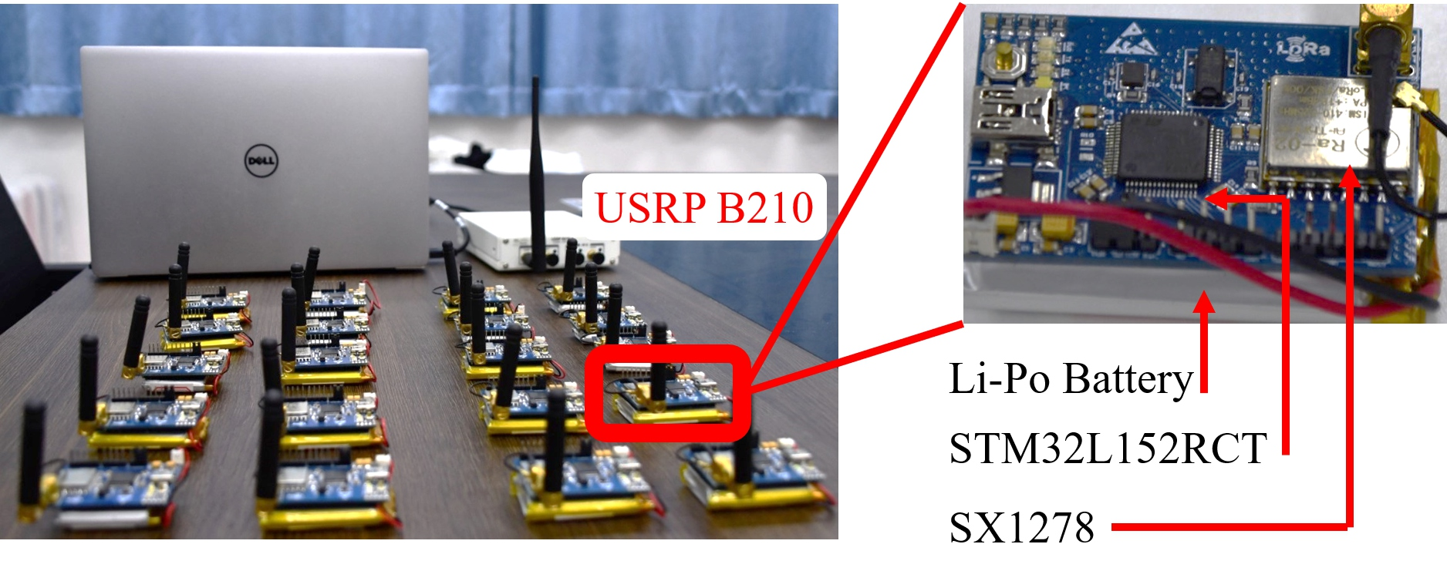
Evaluations (1/4)
Implemented on both USRP
and commodity nodes
Extensive experiments under various settings
Number of nodes
SNR
Distance
Bandwidth
Duty cycle
Evaluated design
SCLoRa
LoRa
Ftrack (SenSys’19)

Slide 29
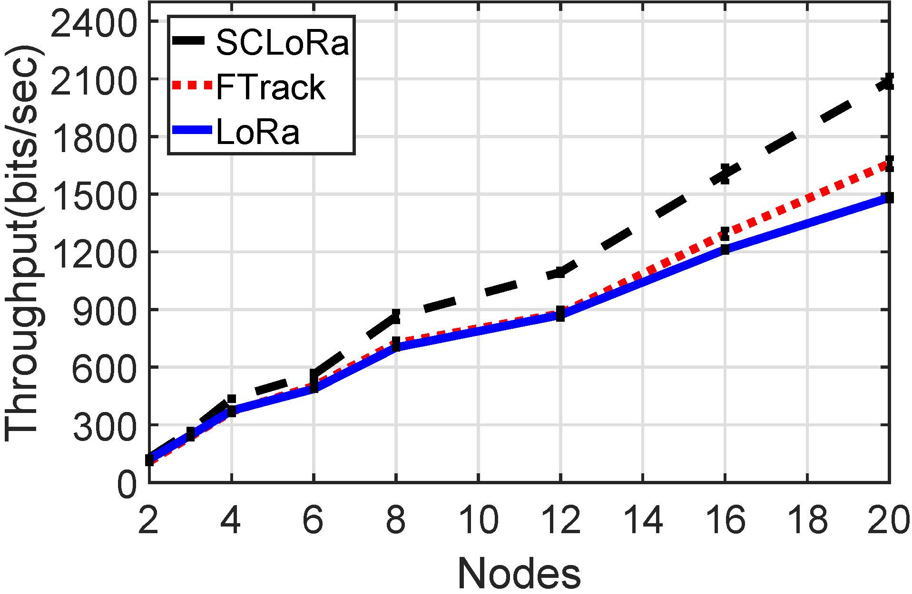
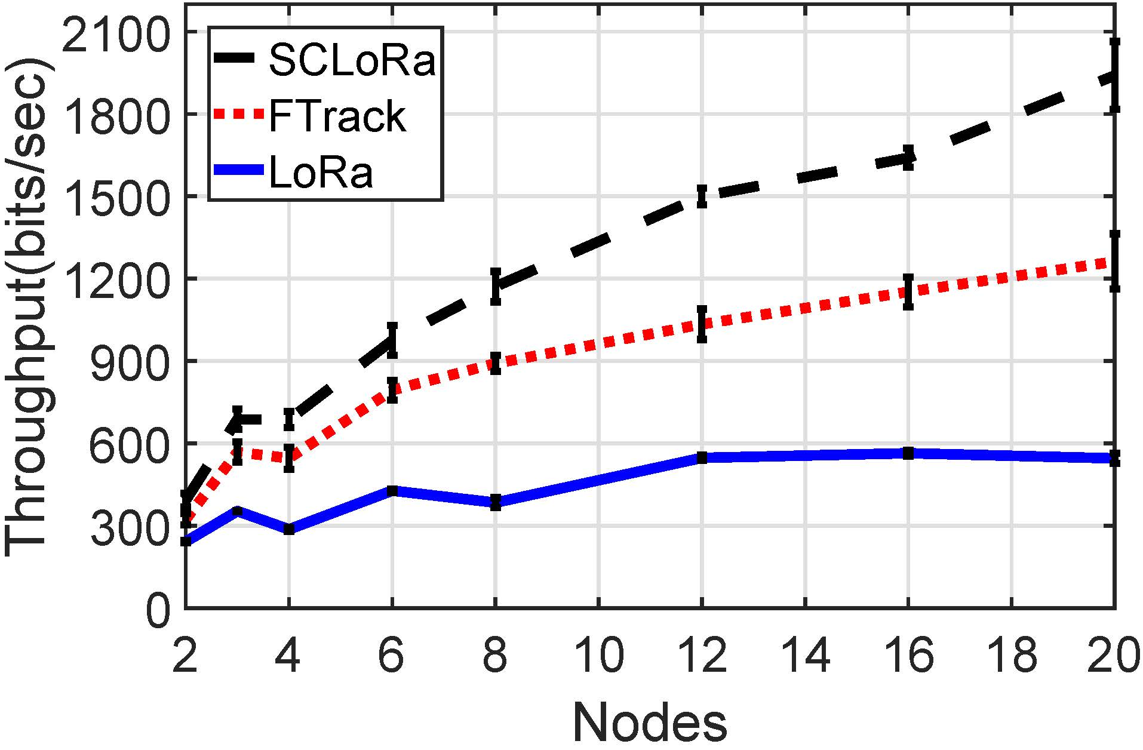
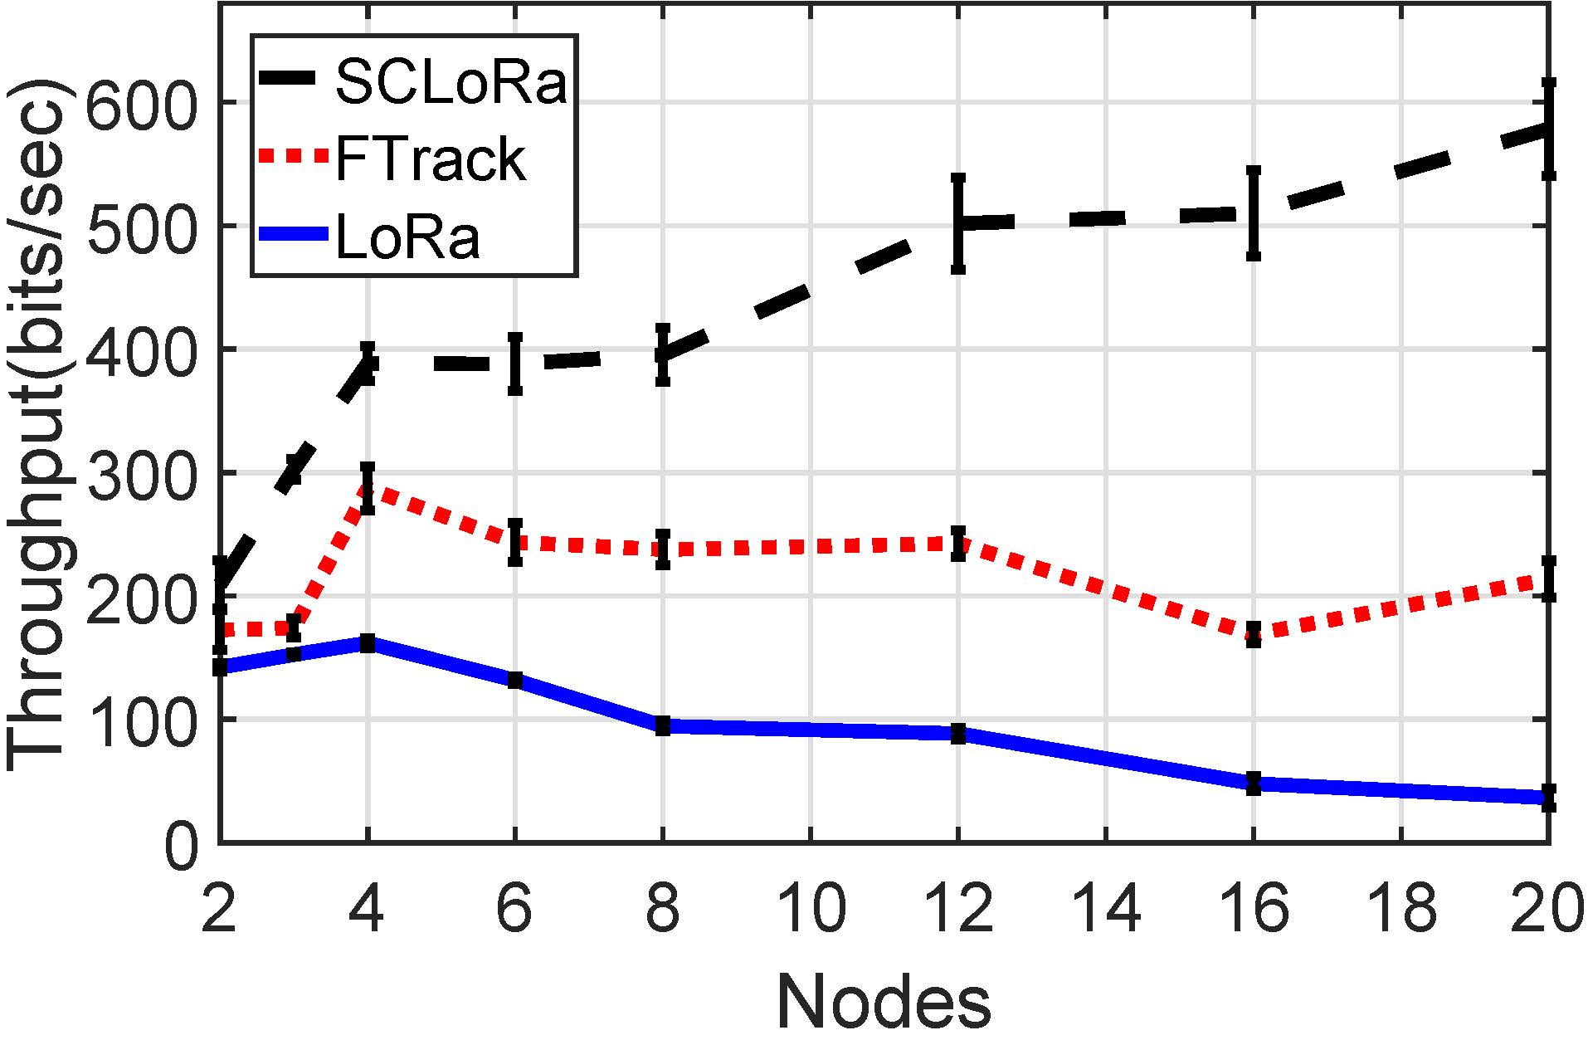
Evaluation (2/4)
The performance of different numbers of nodes
SF: 8
SF: 10
SF: 12
Throughput
2.7 times of FTrack

Slide 30
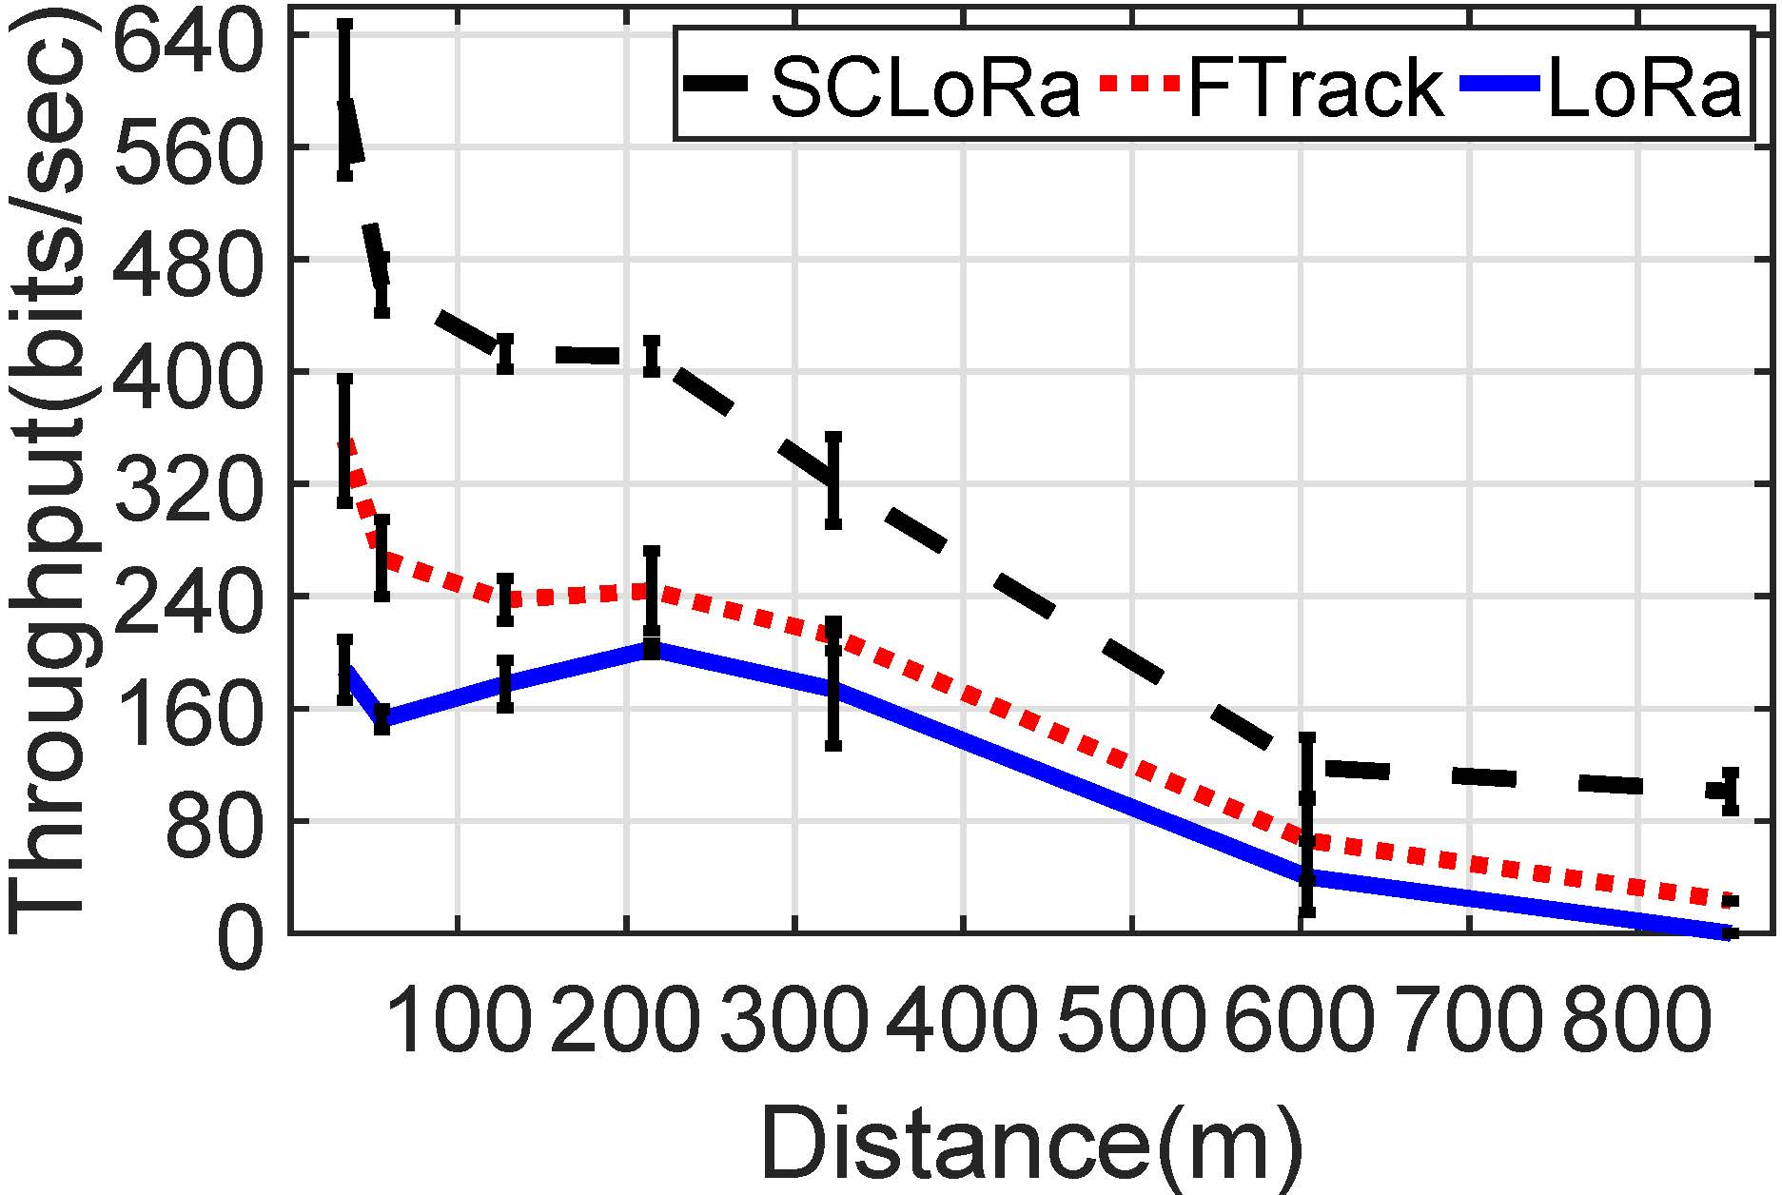
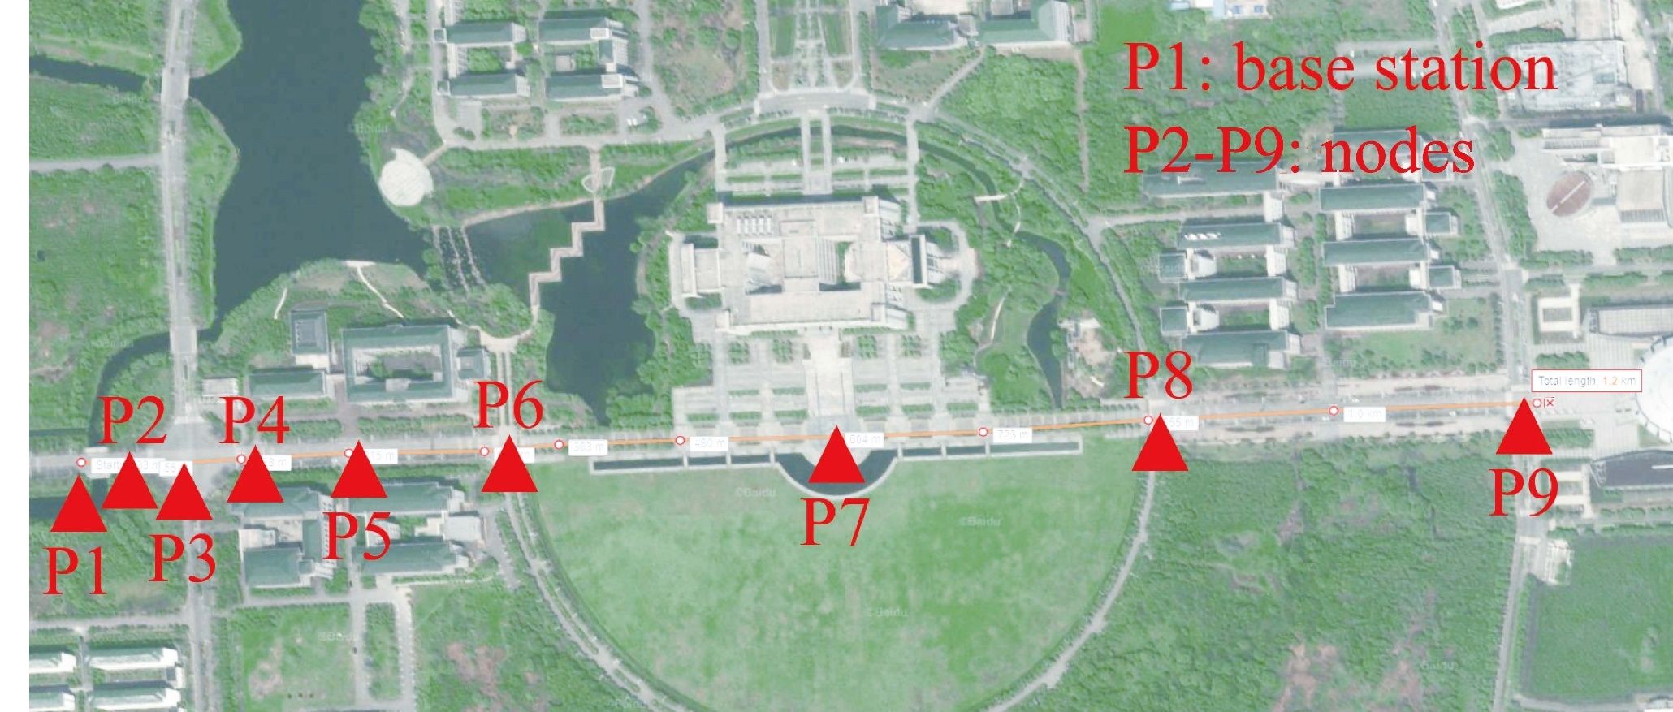
Evaluation (3/4)
The performance of different distance
1KM
Throughput
1.7 times of FTrack

Slide 31
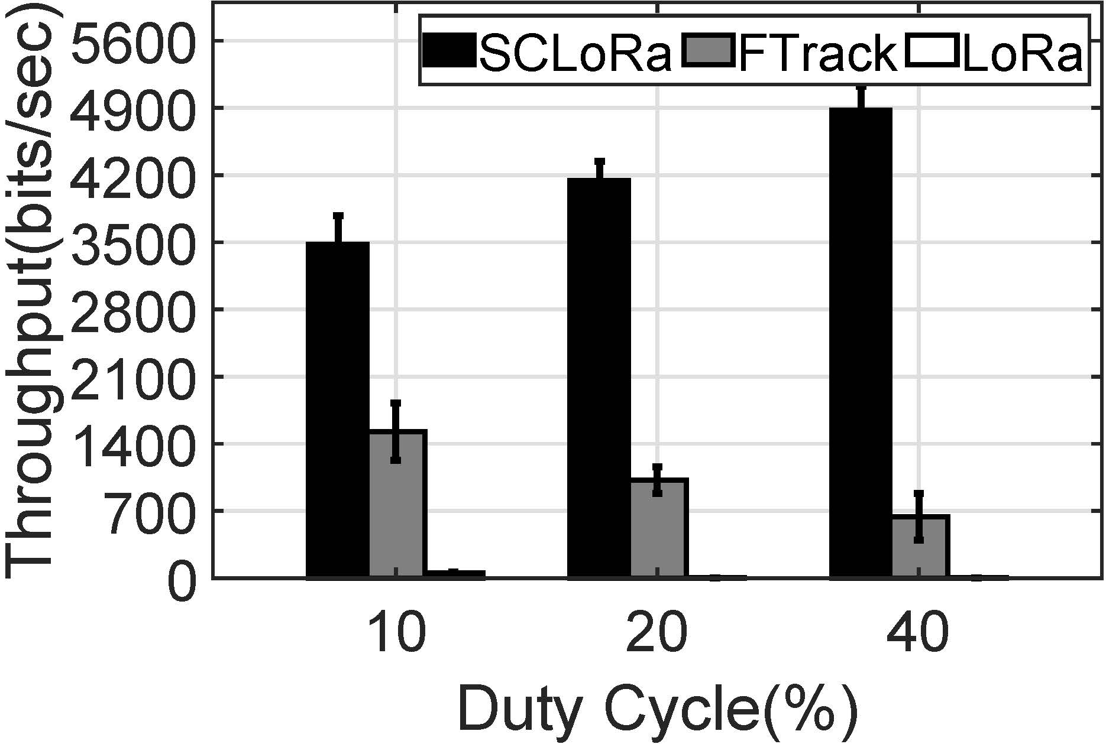
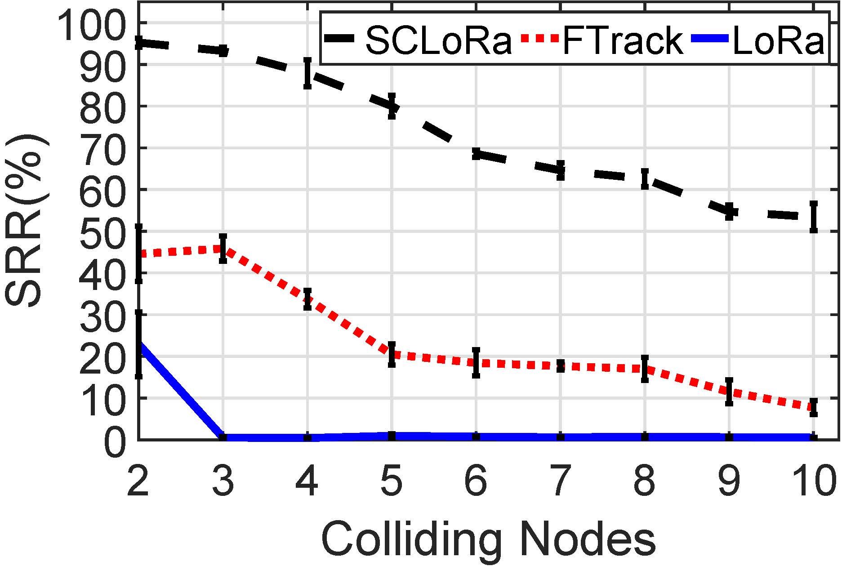
Evaluation (4/4)
The performance of different duty cycles
Collision resolution capability
7.1 times of FTrack
6.7 times of FTrack

Slide 32
Conclusion
SCLoRa: A PHY Mutli-Dimensional Solution for LoRa Collision
First to examine multiple unique features
Resilient to the dynamic environment
Achieving a 3x network throughput of the state-of-the-art

Slide 33

Thank you!
Q&A

